Slide 1
Large Language Models & Transformers
Jayaraj P B
Associate Professor
Department of Computer Science and Engineering
National Institute of Technology Calicut, Kerala, India

Slide 2
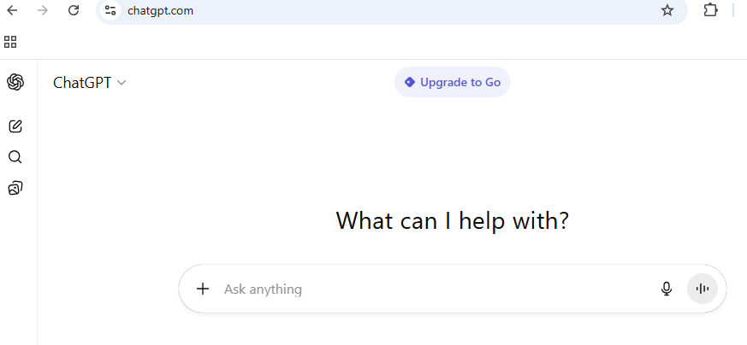


Slide 3
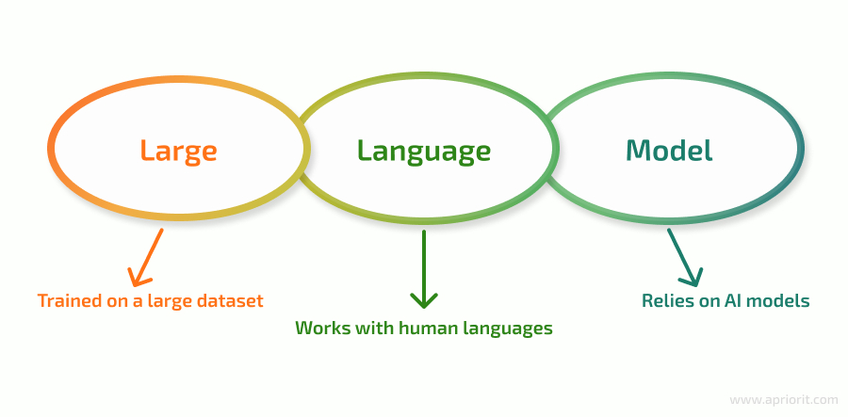
An LLM is a neural network designed to understand, generate, and respond to human like text.
The “large” in “large language model” refers to both the model’s size in terms of parameters and the immense dataset on which it’s trained.

Slide 4
LLM
A Large Language Model (LLM) is an advanced artificial intelligence system designed to process, understand, and generate human-like text.
Pre-trained using a massive corpus of text data.
The underlying technology of LLMs is called transformer.
Transformer is a neural network architecture in deep learning.

Slide 5
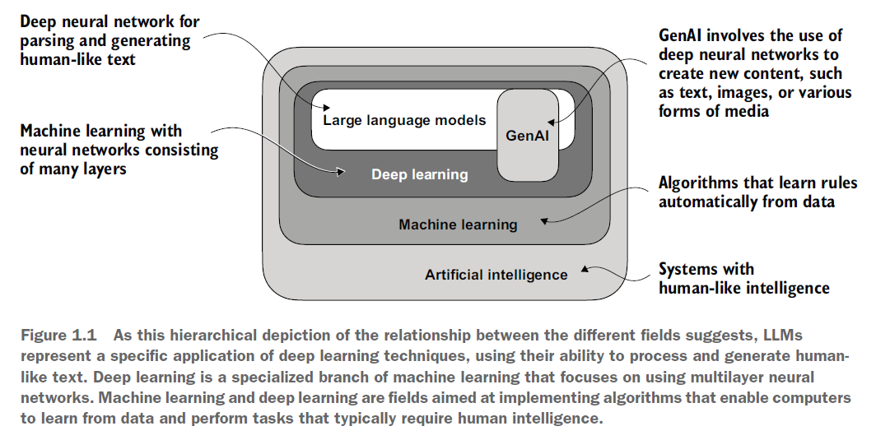

Slide 6
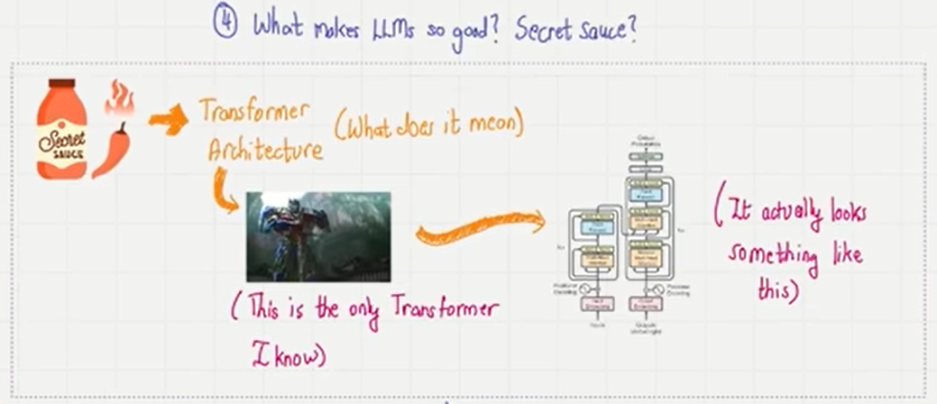

Slide 7
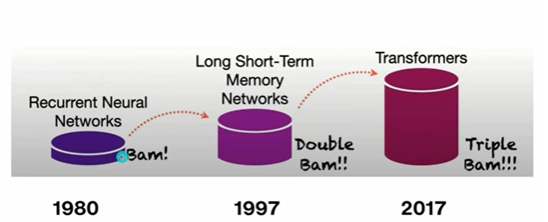

Slide 8
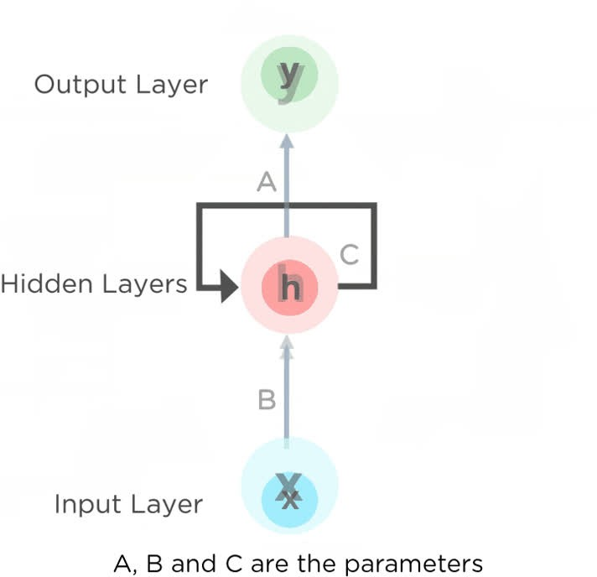
RNNs' problems
Vanishing and Exploding Gradients.
Difficulty with Long-Range Dependencies Sequential Computation
Limited Memory Capacity

Slide 9
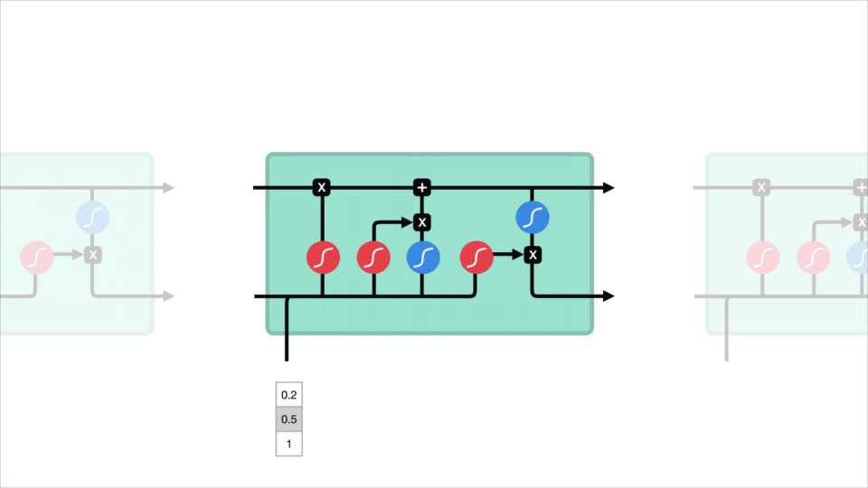
LSTMs problems
Still Sequential
Limited Context Window
Difficulty Scaling to Very Large Datasets Complexity

Slide 10
Main problems
They process the input data sequentially, one after the other.
This makes the training of such models quite slow.
Become ineffective when elements are distant from one another.
Information is passed at each step and the longer the chain is, the more probable the
information is lost along the chain.

Slide 11
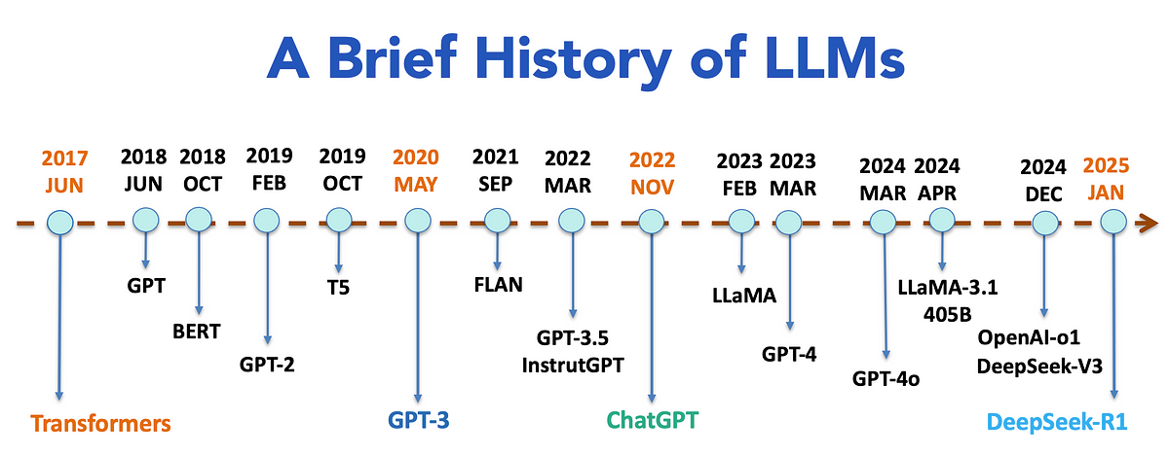
Interestingly, we have reached a point where the gap between closed-source and open-source models is negligible. For instance, LlaMa-3.1 which had comparable performance to GPT-4o is an open-source model while GPT-4o is closed-source

Slide 12
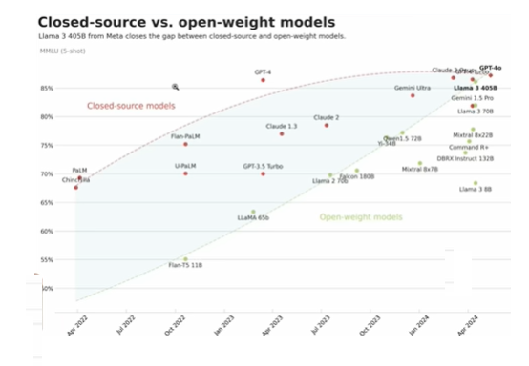

Slide 13
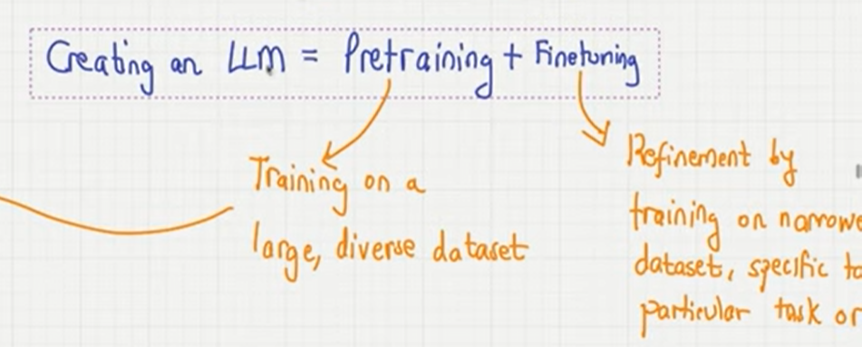

Slide 14
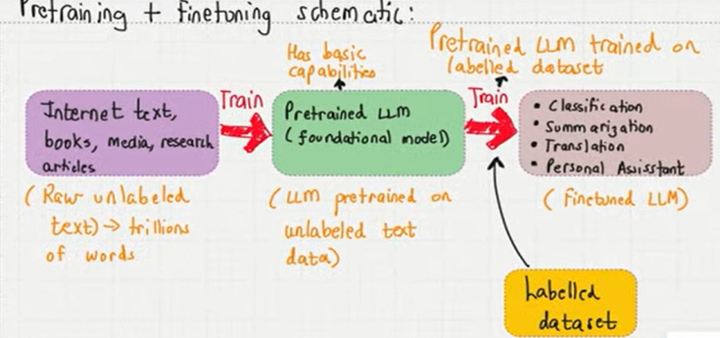

Slide 15

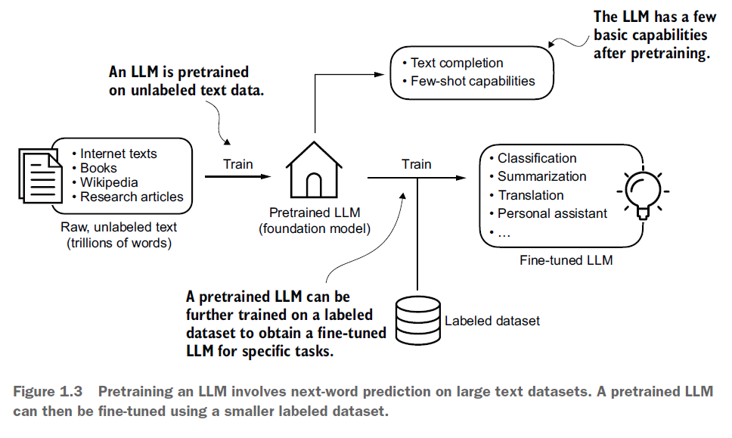

Slide 16
PRE TRAIN
The first step in creating an LLM is to train it on a large corpus of text data, sometimes referred to as raw text.
Here, “raw” refers to the fact that this data is just regular text without any labeling information.
This first training stage of an LLM is also known as pre training.
A typical example of such a model is the GPT-3 model (the precursor of the original model offered in ChatGPT)

Slide 17

FINE TUNING
Refers to refinement by training on a narrower dataset, specific to a particular task or domain.
It's a form of transfer learning where a model, already trained on a broad range of data, is further trained on a smaller, more relevant dataset to improve its performance on that specific task.
For instance, SK Telecom fine-tuned GPT-4
to improve customer service interactions
specifically for telecom-related conversations in Korean.
Another example, Harvey, an AI native legal tool for attorneys, and OpenAI partnered to create a custom LLM for case law.

Slide 19
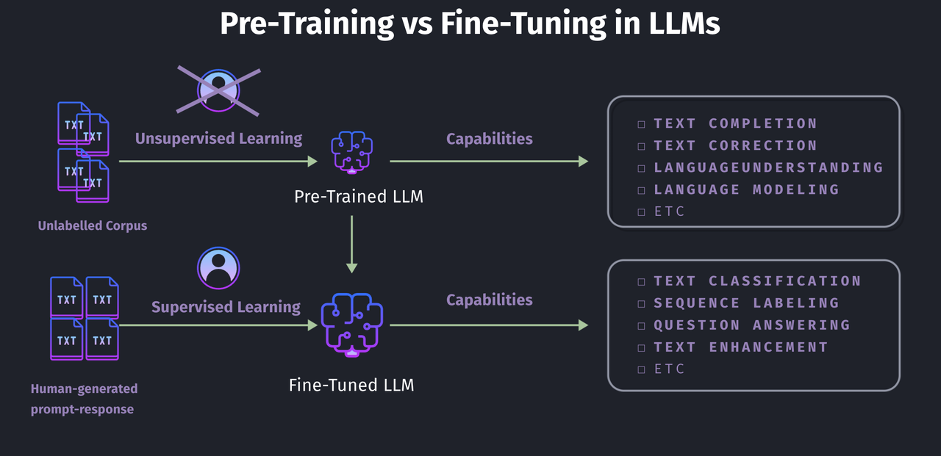

Slide 20
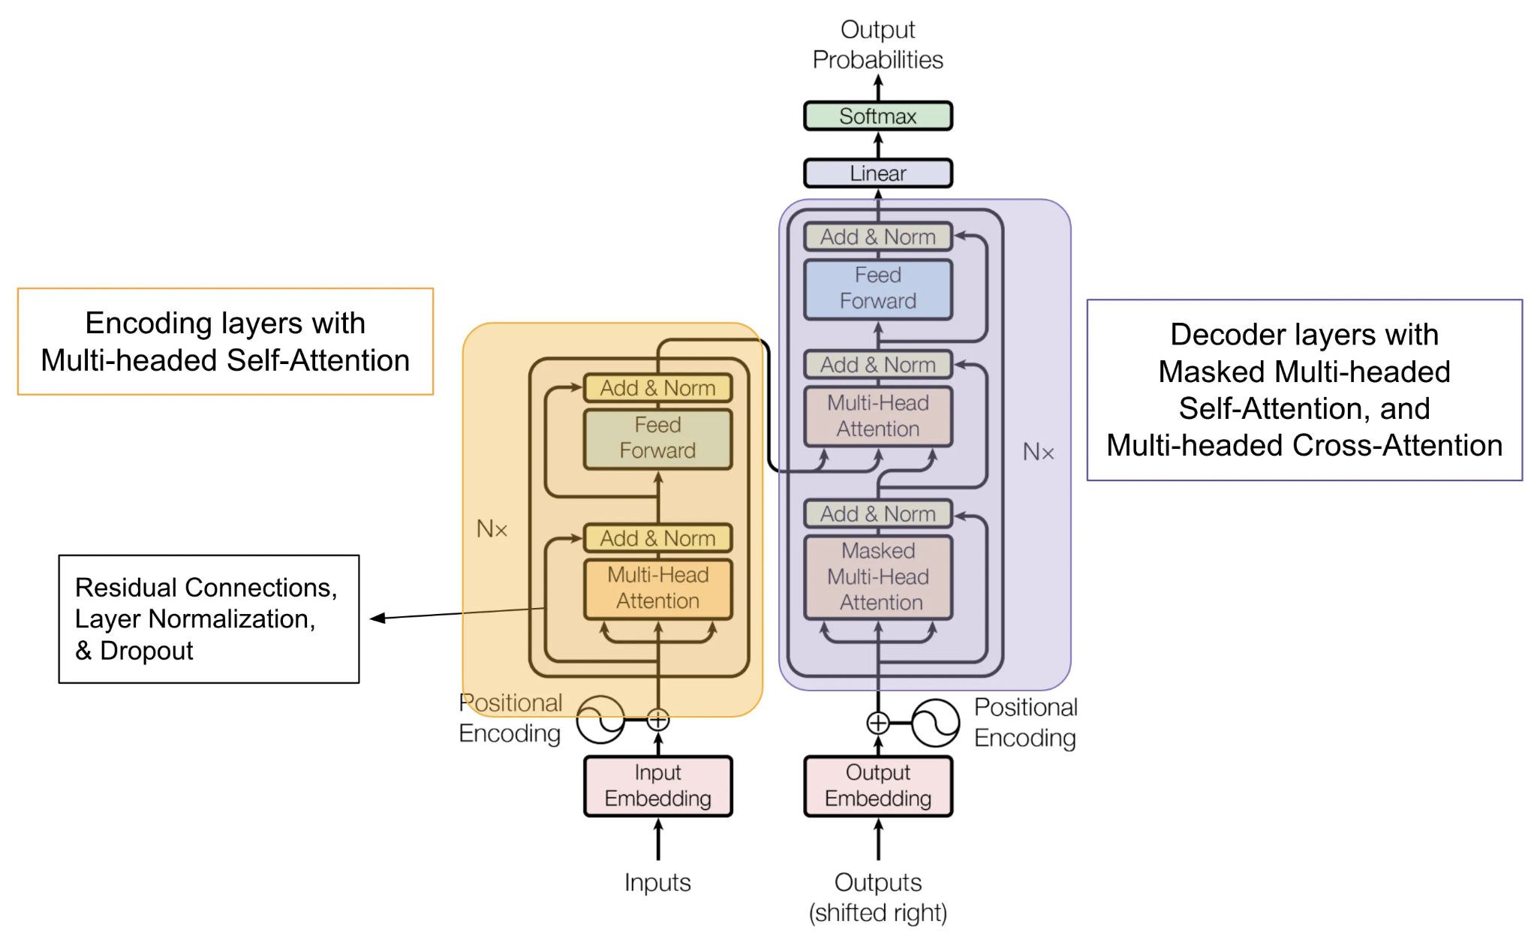

Slide 21
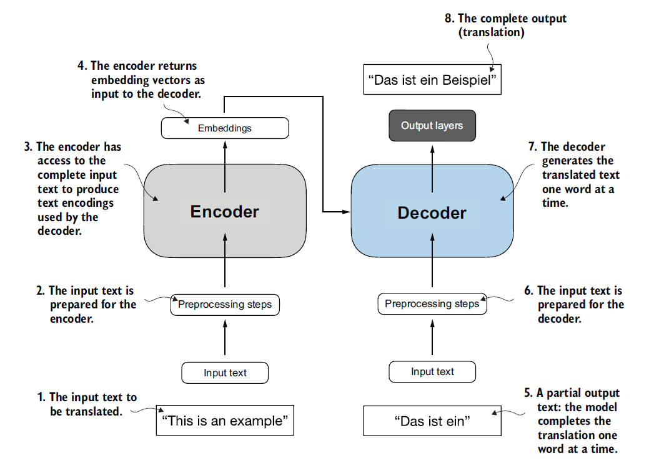
Simplified depiction of original transformer architecture
Step 2 - preprocessing refers to tokenization mostly
Step 3 - produces the encoded numerical representation
This model generates one word after another in the output
Attention mechanism is conveniently avoided here.

Slide 22
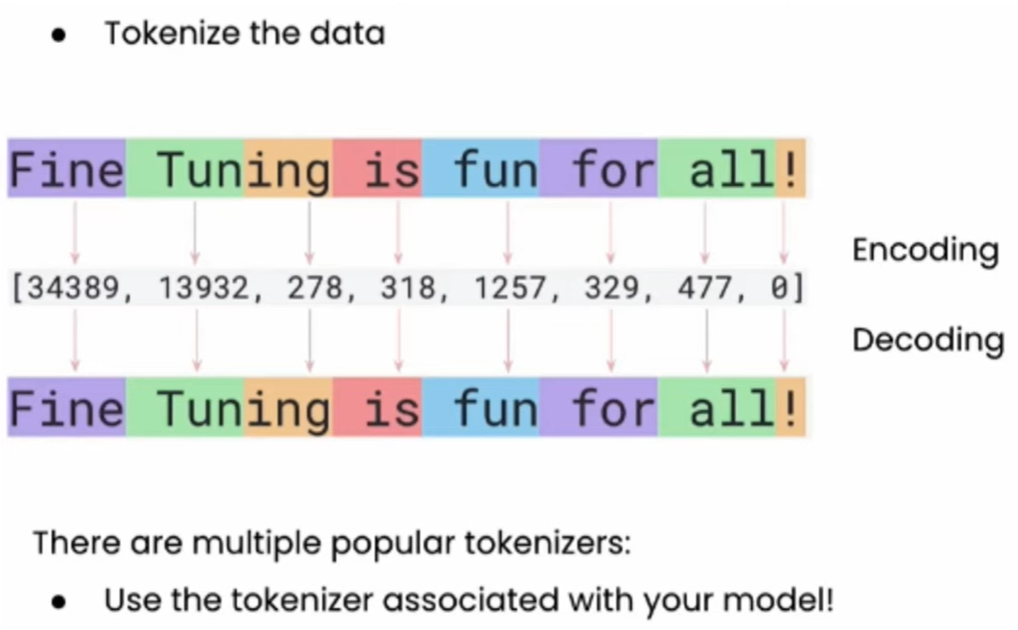
In this case, the tokenizer uses subword-based tokenization. It makes use of the Word Piece algorithm.
This algorithm generates subwords based on the likelihood of characters occurring together.

Slide 23
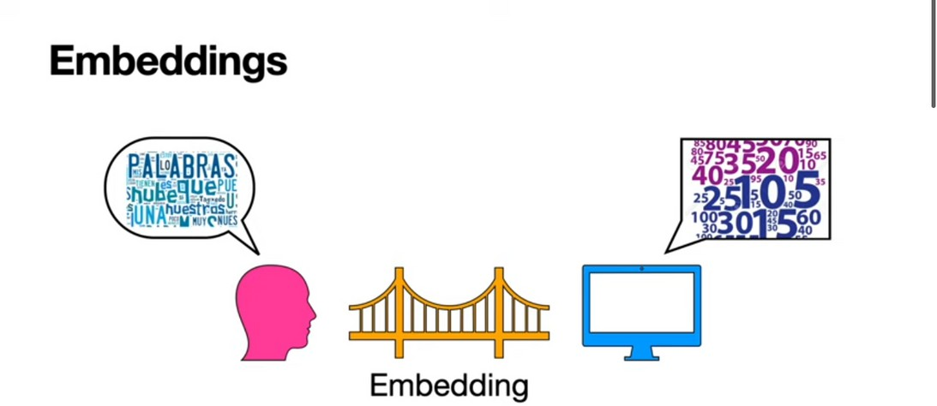

Slide 24
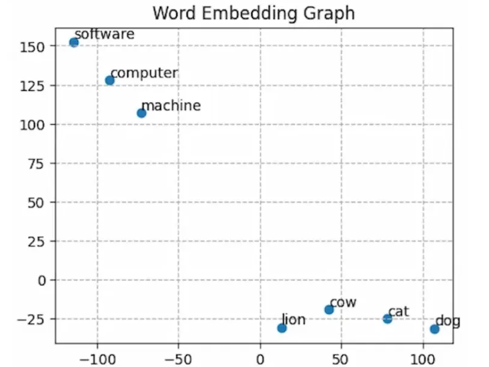

Slide 25
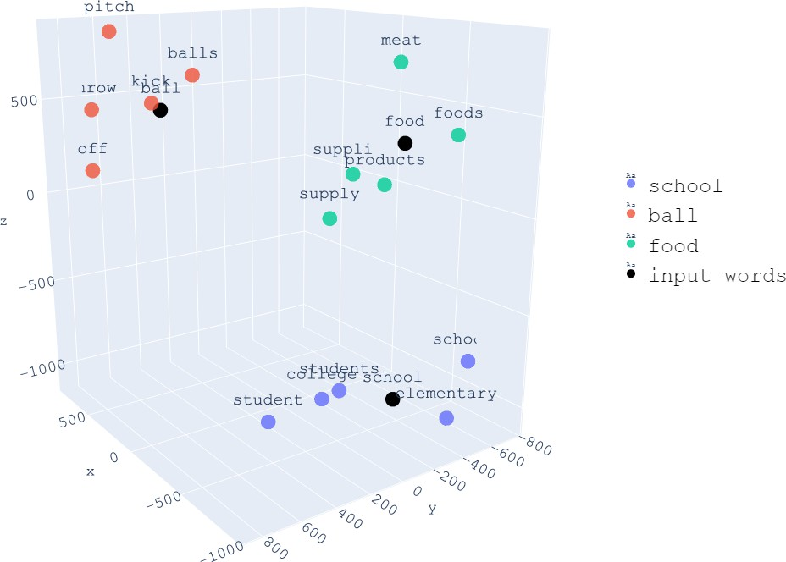

Slide 26
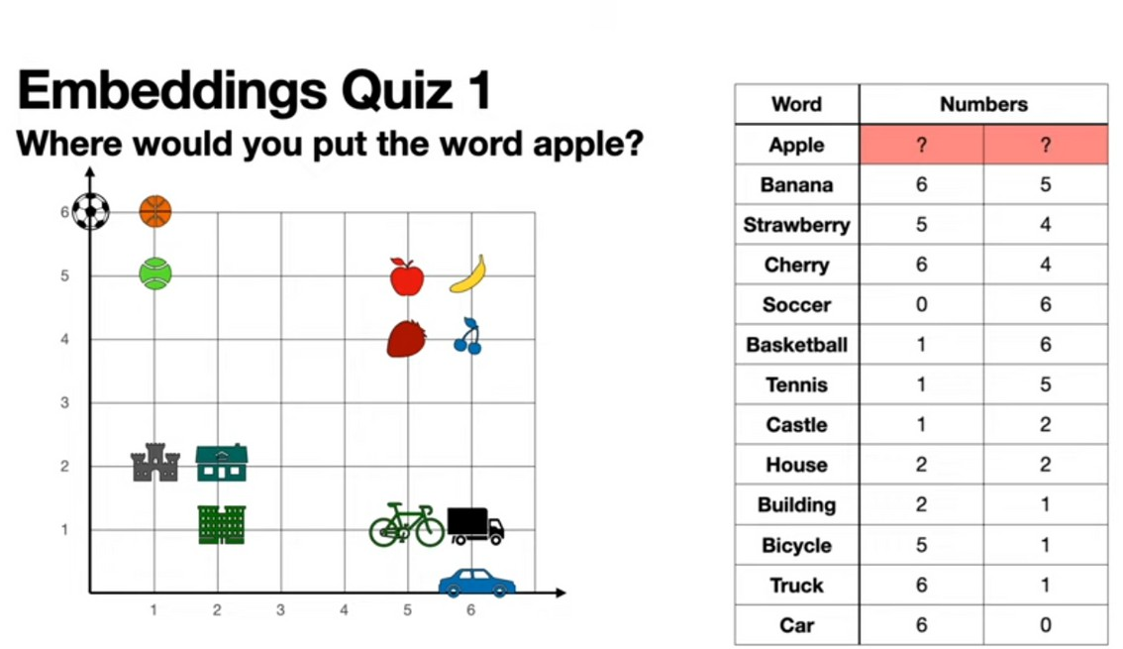

Slide 27
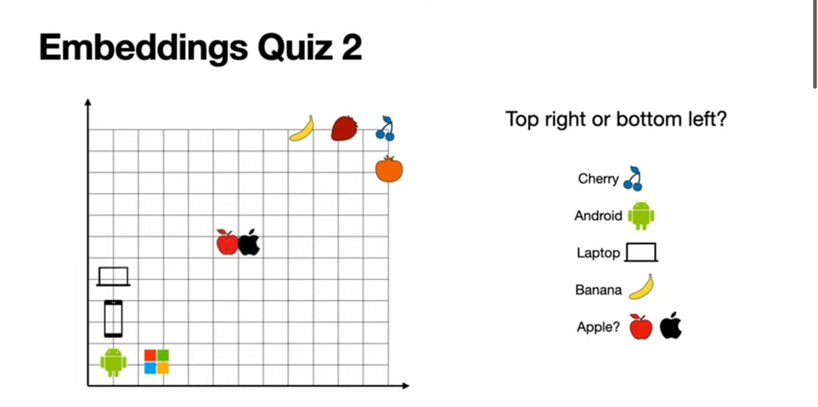
Need to identify context here.
To solve this problem: Attention Mechanism

Slide 28
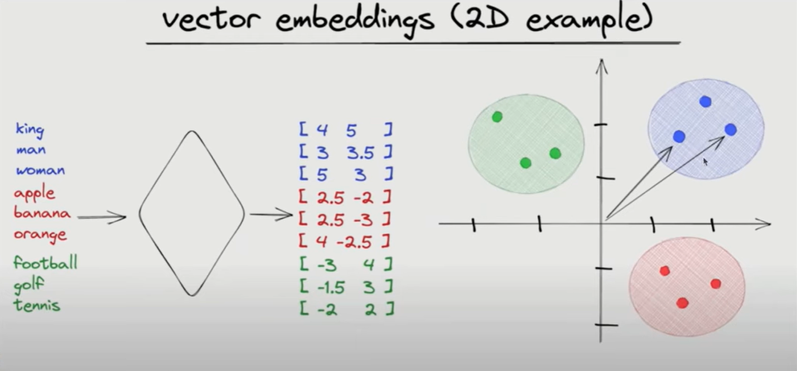
Consider the case of Dog and Puppy
In machine learning, embedding is a way of representing data as numerical vectors in a continuous space.
They capture the meaning or relationship between data points, so that similar items are placed closer together while dissimilar ones are farther apart.
This makes it easier for algorithms to work with complex data such as words, images or audios in a recommendation system.

Slide 29
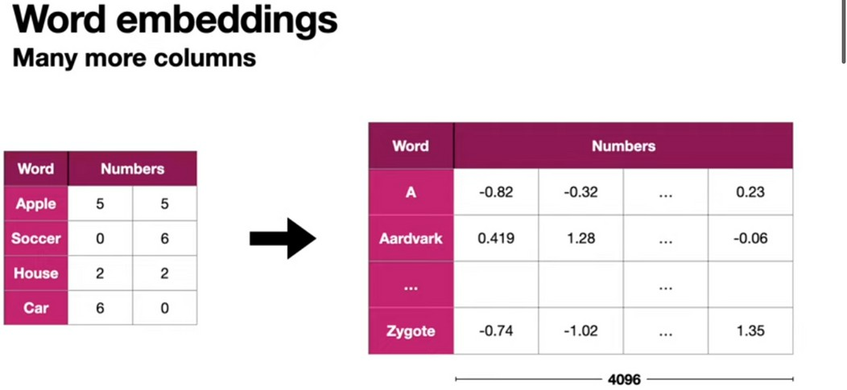

Slide 30
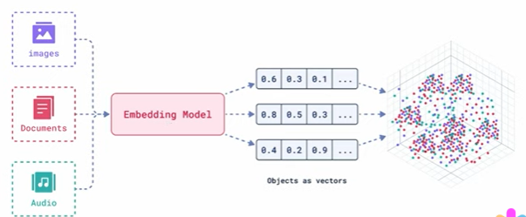

Slide 31
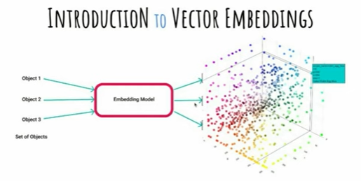

Slide 32
ZERO SHOT
LEARNING
Ability to generalize to completely unseen tasks without the need for any example
ONE SHOT LEARNING
In addition to the task description, the model sees a single example for the task which user inputs
FEW SHOT
LEARNING
Learning from a few examples before generating the output. The user has to provide the examples as input
GPT-3 proved to be very effective provided the prompts give to it followed the few-shot pattern. It also has zero-shot capabilities, but its few-shot capabilities are much stronger.

Slide 33
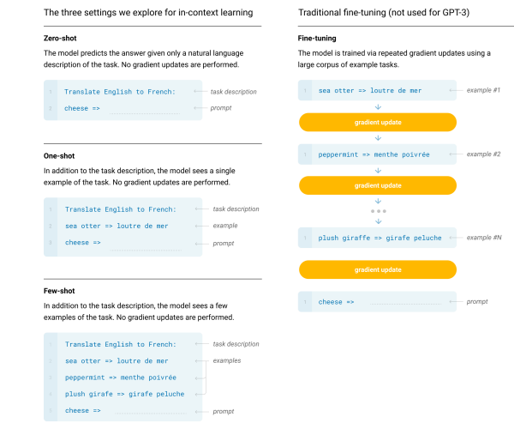

Slide 34
Attention Mechanism
Helps LLMs to understand whole context of the text.

Slide 35
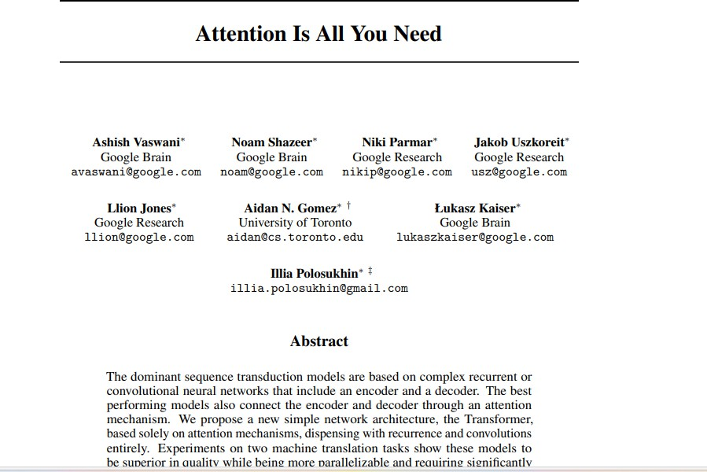

Slide 36


Slide 37
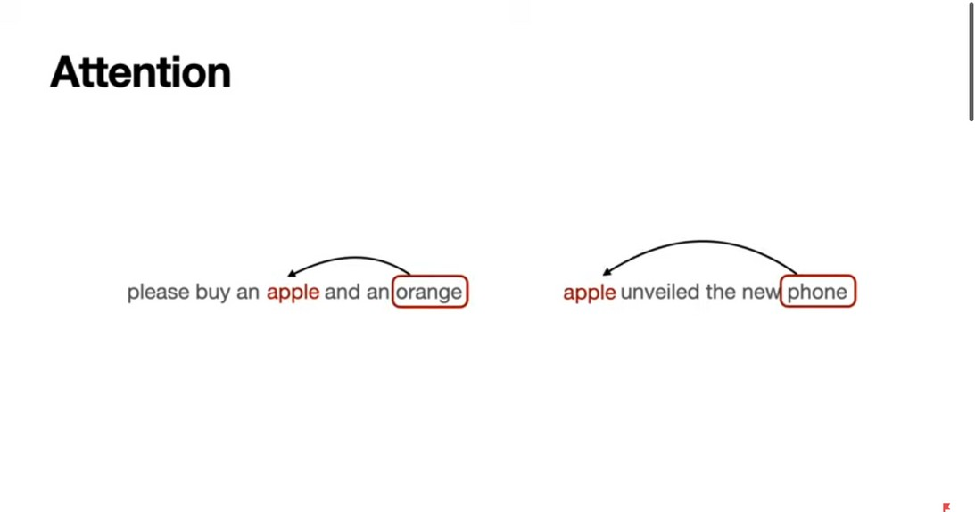

Slide 38
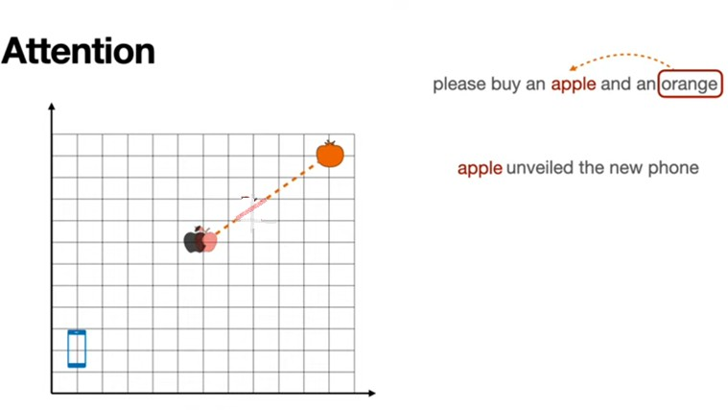

Slide 39
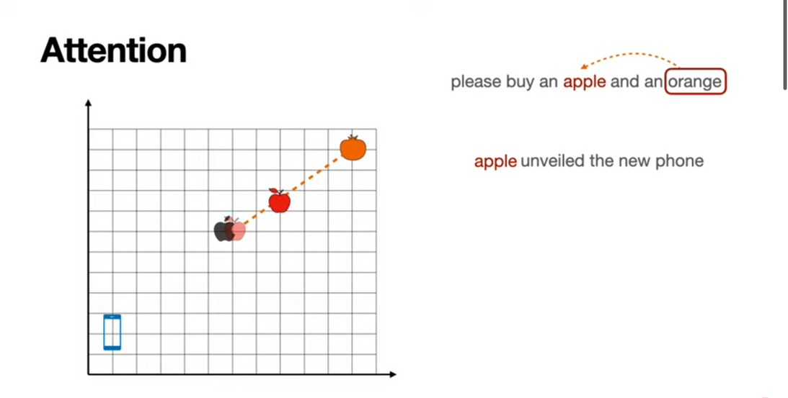

Slide 40
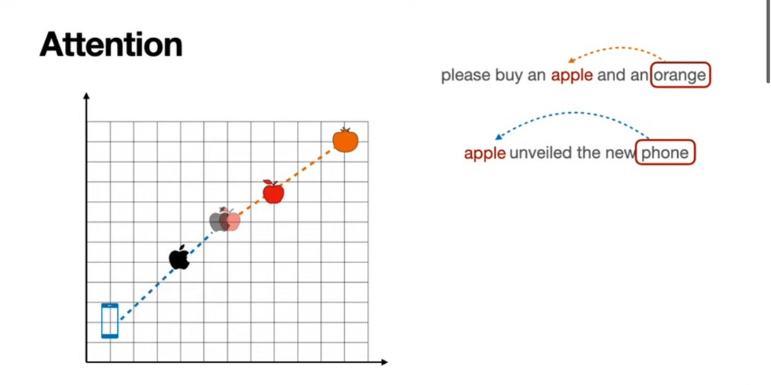

Slide 41
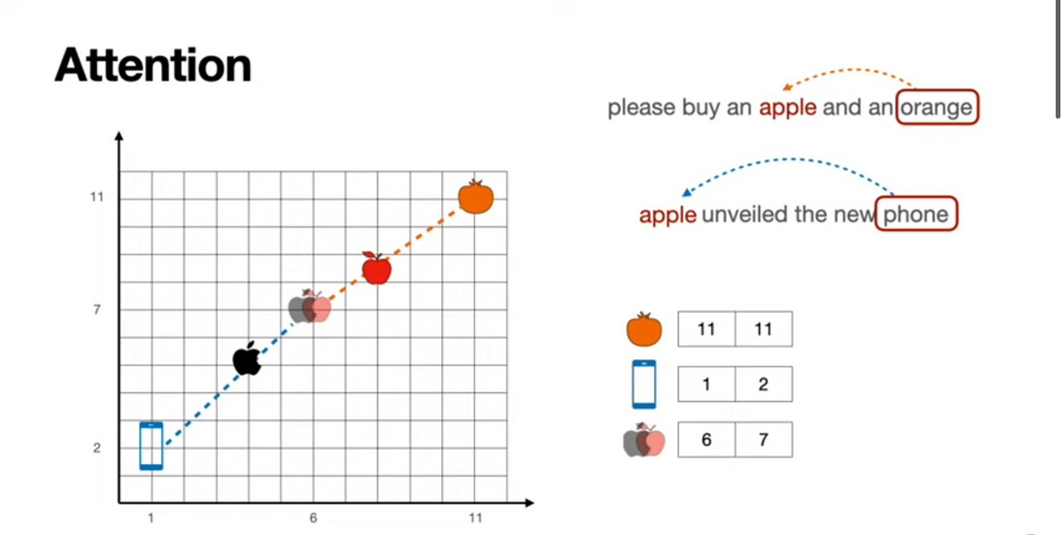

Slide 42
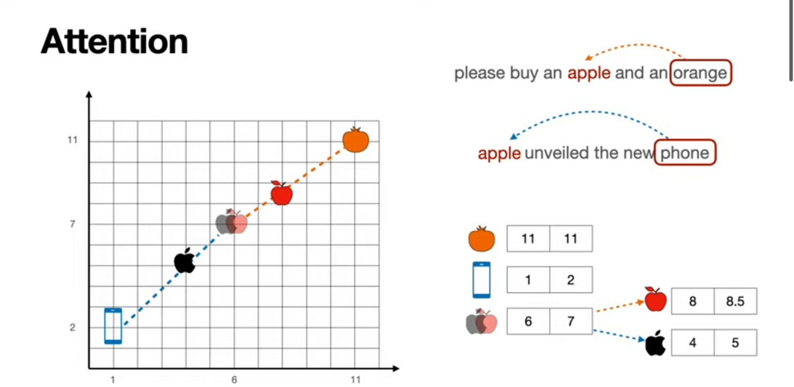

Slide 43
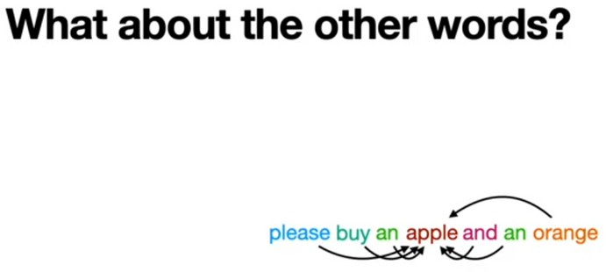

Slide 44
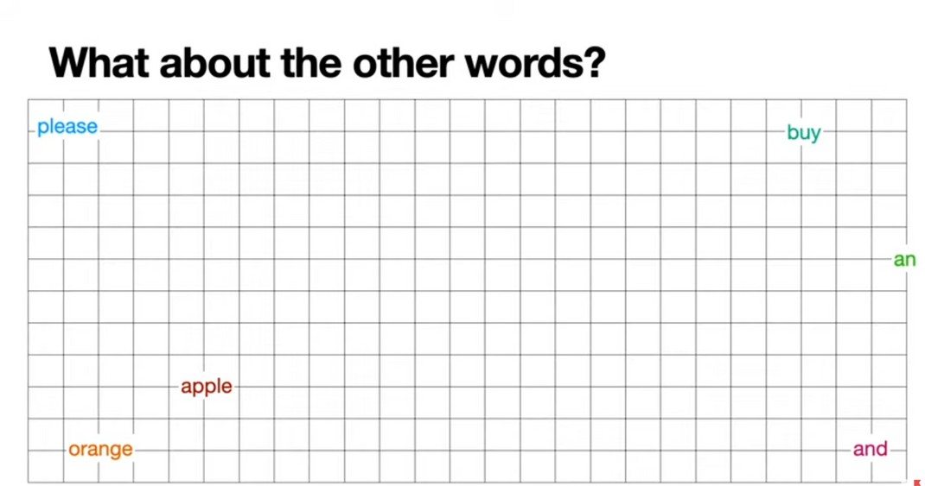

Slide 45
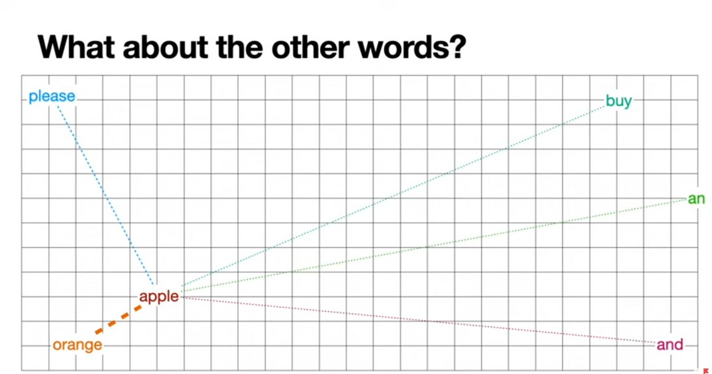

Slide 46
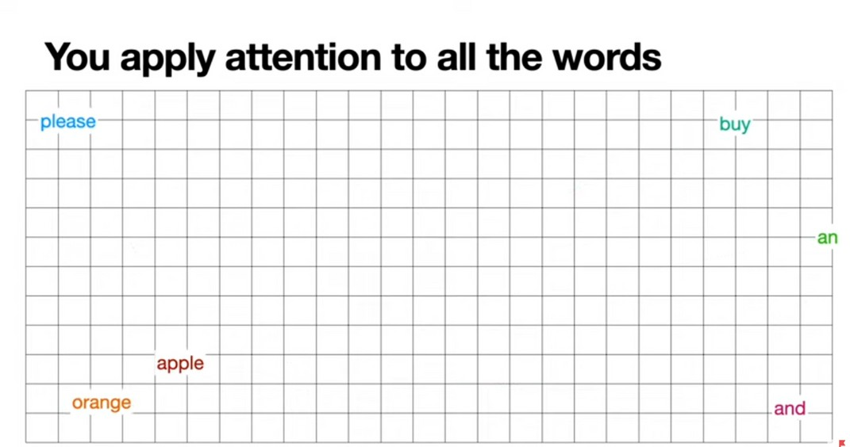

Slide 47
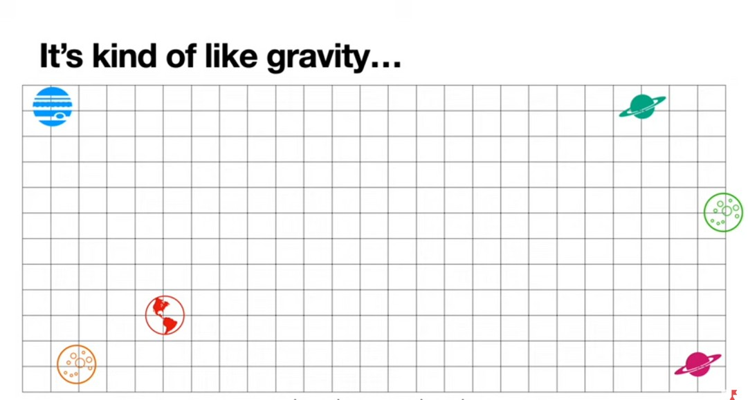

Slide 48
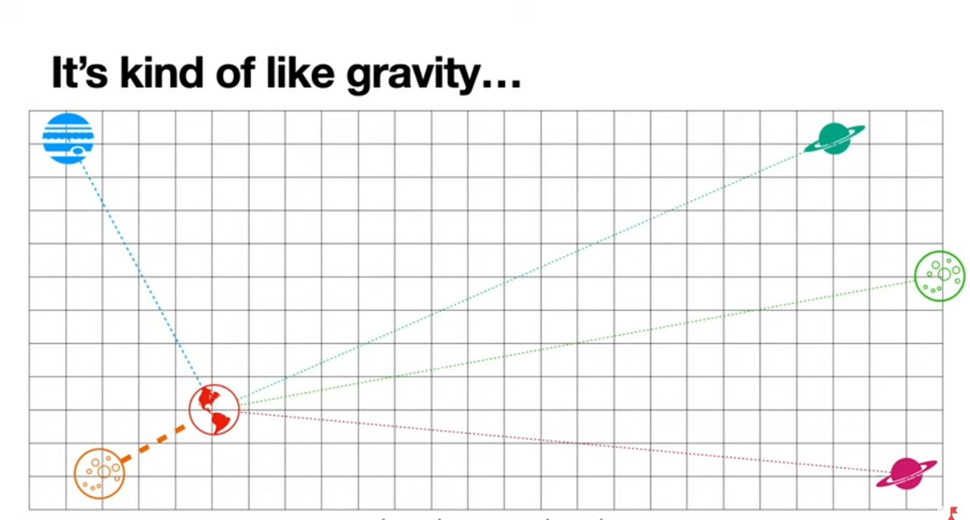

Slide 49
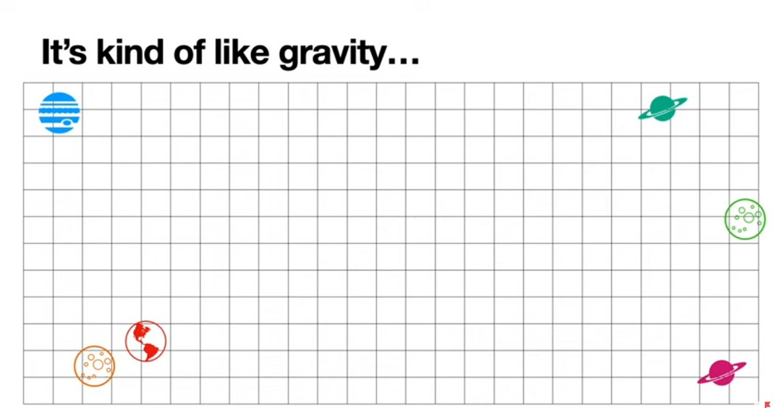

Slide 50
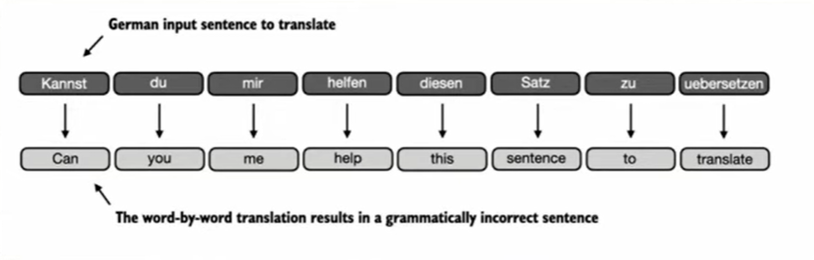
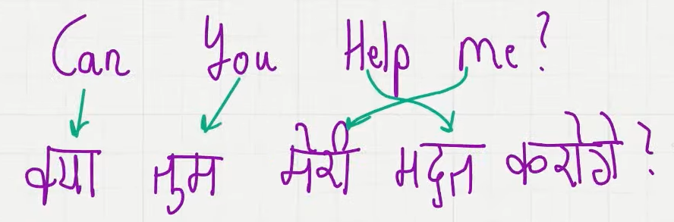
SELF-ATTENTION MECHANISM
Allows the model to weigh importance of different words/tokens relative to each other
Allows model to capture long range dependencies (drawback of RNNs and LSTMs)
ORIGIN OF ATTENTION
Initial language tasks were translation tasks - word by word translation never works. This was realized when long sequence modeling was done
Sometimes, the translated text contains different number of words

Slide 51
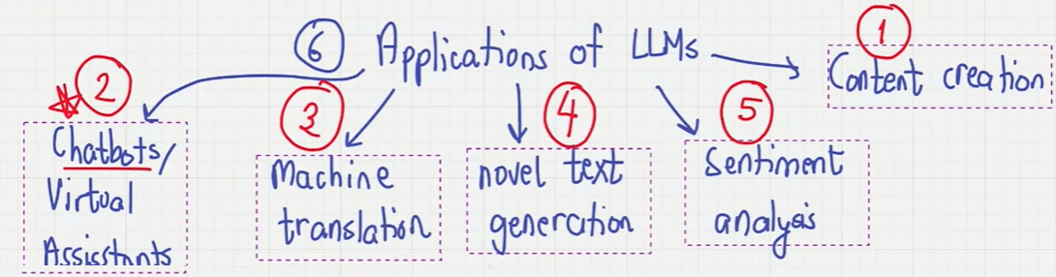

Slide 52
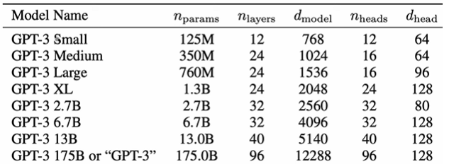
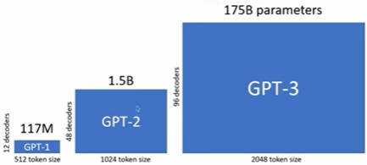
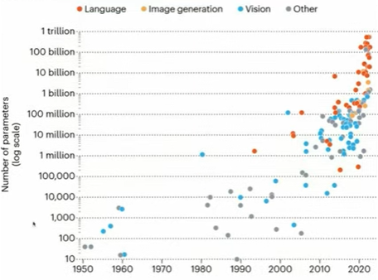

Slide 53
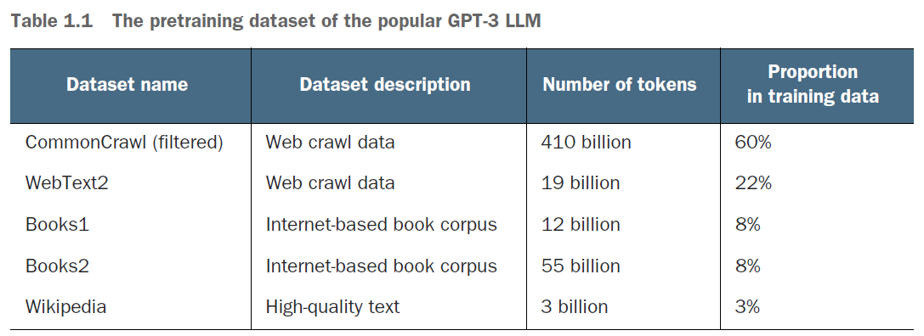
Pre trained model MODEL
Fine Tuning is performed on this model
From this, roughly 300B tokens were used for training
The total pre-training costs for GPT-3 was nearly 4.6 million dollars!

Slide 54
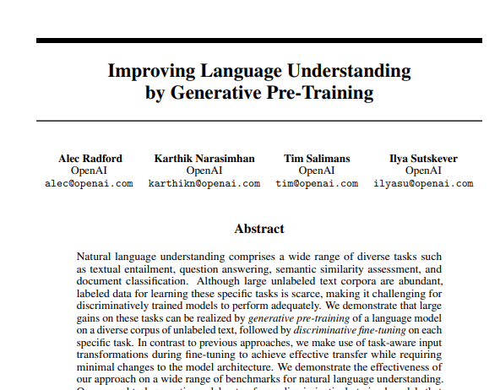

Slide 55
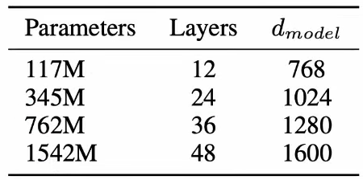
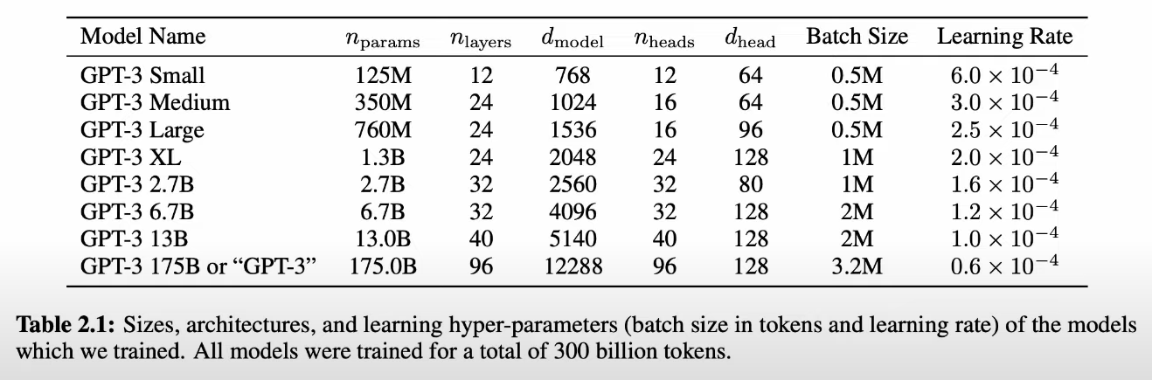
Generative Pretrained Transformer
OpenAI came up with the idea that generative pre-training on a large corpus of unlabelled data followed by discriminative fine tuning had significant advantages
Parameters typically refer to the weights in neural network
4 Versions of GPT-2
8 Versions of GPT-3

Slide 56


Slide 57


Slide 58

Although the dataset is unlabelled, the correct output serves as a label enabling self-supervised learning.
Everytime an incorrect label (here, word) is predicted, error is calculated and weights are updated accordingly ensuring better prediction in the next attempt.
Original transformer used 6 encoder-decoder blocks
GPT-3 uses 96 transformer layers (decoder only) constituting 175B params

Slide 59

GPT (Generative Pretrained Transformers) is designed for generative tasks - decoder only architecture
BERT (Bidirectional Encoder Representations from Transformers) and its variants specialize in masked word prediction
[CLS] token marks the beginning of input sequence
[SEP] token separates different sentences or parts of sentences within a single input sequence
Example:
Single sentence: [CLS] This is a sentence. [SEP]
Sentence pair: [CLS] This is the first sentence. [SEP] This is the second sentence. [SEP]

Slide 60

BERT is bidirectional because it tries to find the missing word from both sides. This enables it to capture relationship between words important for understanding the context. (It effectively differentiates between homonyms by looking at nearby words)
GPT on the other hand, only predicts the last word i.e, only the word at the end

Slide 61



Slide 62

Mistral 7B
Outperformed LlaMa-2 7B, LlaMa-2 13B and even Llama-1 34B in some benchmarks (code, reasoning, math etc)
Completely Open Source
A fine tuned version of Mistral 7B - Zephyr has outperformed LlaMa-2 70B
4 main components
1) Sliding Window Attention
2) Grouped Query Attention
3) Rolling Buffer Cache
4) Prefill and Chunking

Slide 63

BUILDING AN LLM FROM SCRATCH!
Fine tuned LLMs can outperform pre-trained LLMs for that specific task

Slide 64


Slide 65


Slide 66
Thank You !!!

